Slide 1

Online Clothing Store
Ashmina Dangat - 20104052
Neha Chaudhary - 20104134
Kritika Donde - 20104102
Sakshi Gunjal - 20104106
Project Guide
Ms. Manasi Choche
Notes:
1

Slide 2


Contents
Introduction
Objectives
Scope
Features / Functionality
Project Outcomes
Technology Stack
Block Diagram
Notes:
2

Slide 3
1. Introduction
The most convenient aspect of the internet is its time – saving nature, online shopping sites has seen an exponential growth,with a huge increase in the number of consumers choosing to buy online rather than in store.
Problem Identified :
Lack of time in this busy lifestyle of people.
There are limited stock of products in stores.
Solution Proposed :
You can use the website from where ever you are for the better and easier shopping experience.
This website also saves time as there is no walk in store to buy clothes and you just have to add them to your cart and order your clothes.
Notes:
3

Slide 4

2. Objectives
To create a user-friendly website for shopping.
To save time.
To have various categories and varieties to choose from.
To avoid physical effort required to buy things.
To make products cost effective.
To also make selling easier for companies..
Notes:
4

Slide 5
3. Scope
Reach gets increased.
Cost effective.
24/7 service.
People can shop from wherever they want
Very useful to elderly people, differently abled people who are confined to their homes.
Variety of options.
Also avoid many health issues.
Notes:
5

Slide 6

4. Feature /Functionality
Feature 1 :
A user friendly website.
Feature 2 :
A detailed product description and various categories for men and women.
Feature 3 :
All types of payment modes.
Notes:
6

Slide 7
5. Outcome of Project
Anyone can login in to the website after registration.
User can search for products available for both male and female.
User can have a detailed information about the product and sizes available.
User can add the products they want to buy to the Wishlist / Cart.
User can make the payment online and offline.
Notes:
7

Slide 8



6. Technology Stack
Py Qt -5
Visual code
My SQL
Notes:
8

Slide 9
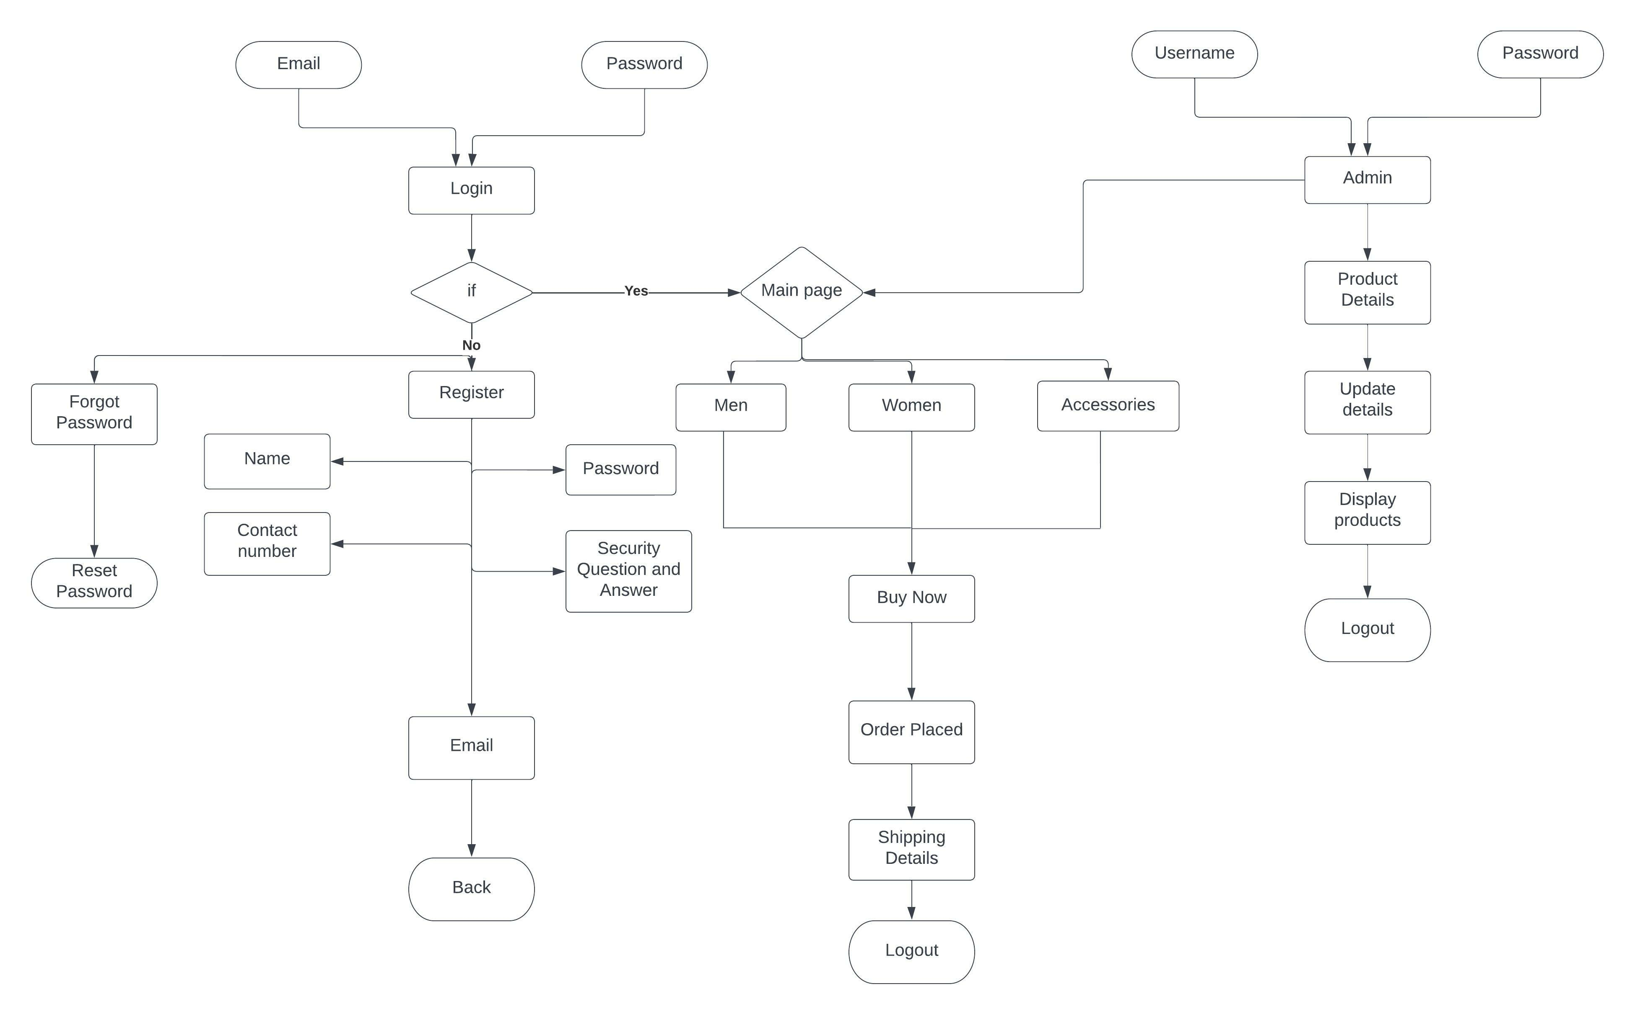
7. System Flow
Notes:
9

Slide 10
Thank You...!!
Notes:
10

